Slide 1

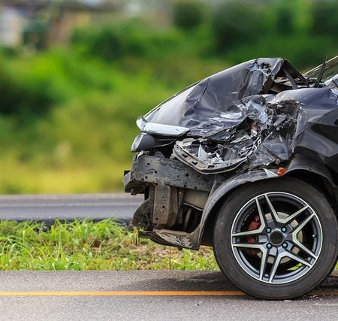
Road Fatality Analysis
Descriptive and Predictive Modeling on road accidents in US.
Group 6
Presentation

Slide 2
our team
Gurjinderpal Singh
Jaya Rudra
Raju Produttori
Bhanuchander reddy
Jasleen Kour Chibber

Slide 3


Road Crashes in US
Data from NHSTA
over 37,000 people die in road crashes each year
9th leading cause of Death
Accounts for 2.2% of all deaths globally
Background for Problem
Cost
Road crashes cost the U.S. $230.6 billion per year

Slide 4
Problem Statement & proposed Analysis
Identifying underlying factors
Descriptive Analysis
Factors Contributing to accidents are multifaceted, including weather conditions, road infrastructure and driver behavior.
Use Descriptive Analysis to Identify trends and corelated factors to accidents.
Predicting High risk crashes.
Predictive model
The Complexity of these factors makes tackling road safety a challenging task for policy makers.
Develop a predictive model which can help emergency services to prioritize dispatch of resources.

Slide 5

Project methodology
Python, Pandas
Tableau
Data Cleaning
EDA
Visualizations
Dashboards
01
02
04
03
Azure
Sklearn, Keras
Build Inference pipeline in azure Machine learning Studio.
Deploying API endpoint for model Consumption.
Encoding data
Build ML Models, ANN

Slide 6

Dataset Description
47 Attributes include
Location
Time
Weather
Points of interest
500k
Resources
Accidents records
Spanning from 2019 to 2022
Datatypes
Integer
Categorical
Boolean
Traffic APIs recording Road accidents for whole USA

Slide 7
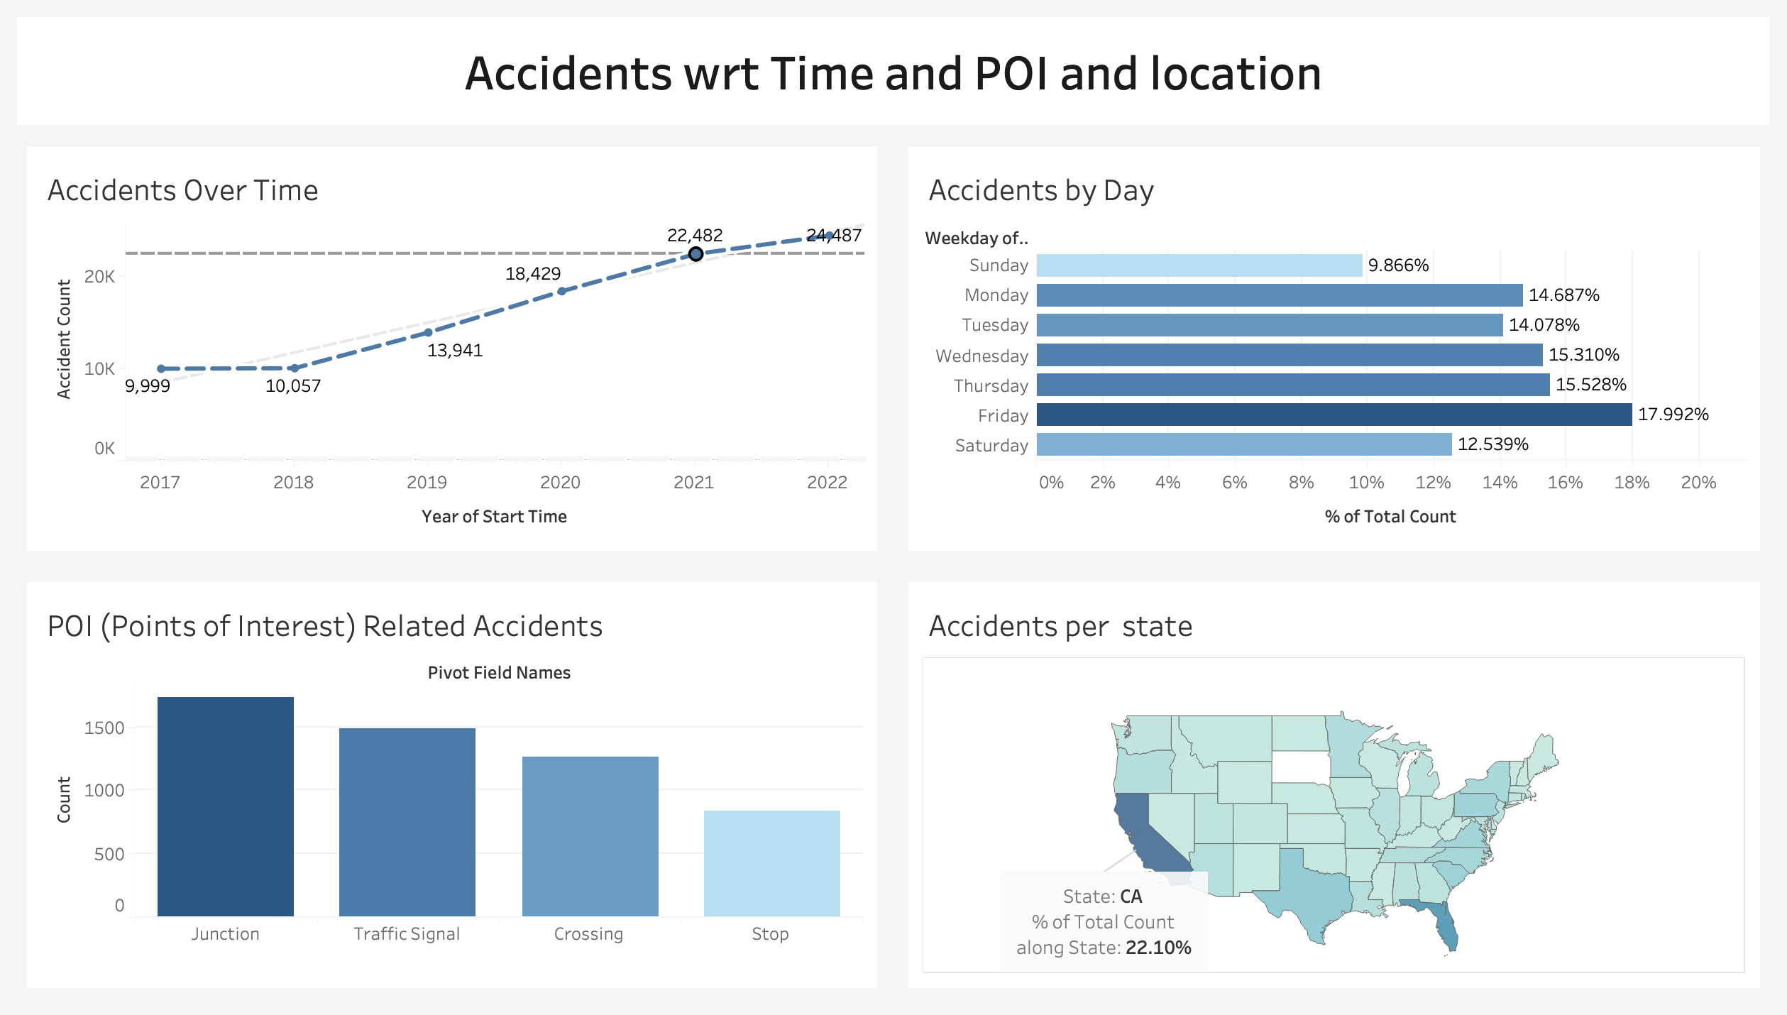
Descriptive Analysis

Slide 8
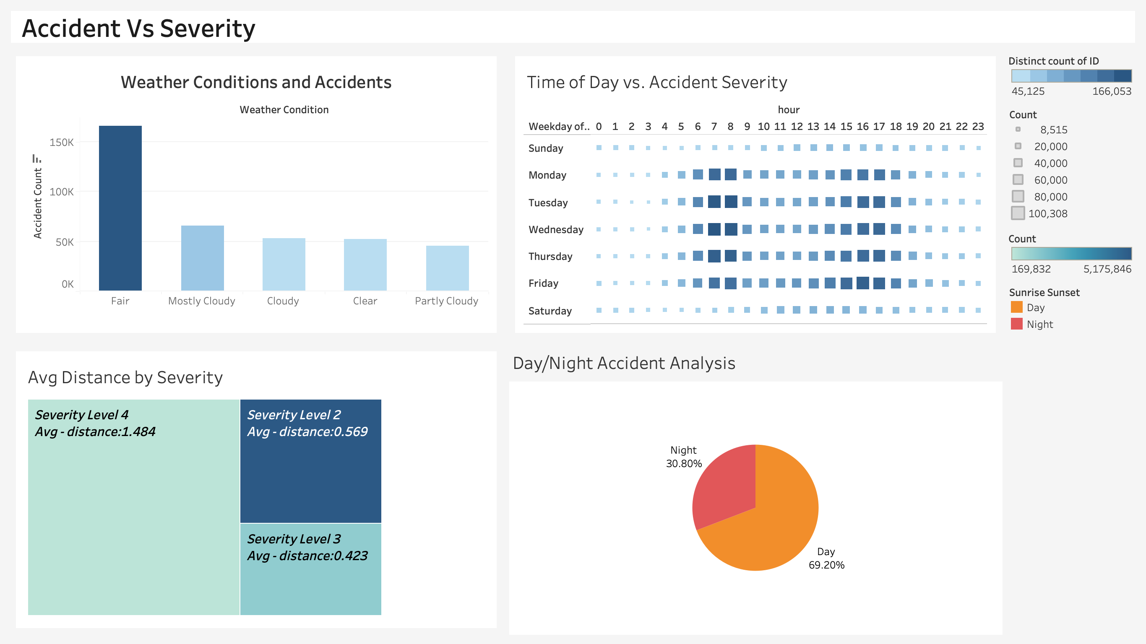
Descriptive Analysis

Slide 9
Insights from Analysis
Humidity and high temperatures were significant factors in accident rates, both during the day and at night.
01
Most accidents occurred on fair weather days rather than cloudy or problematic conditions.
04
California (especially Los Angeles), Florida (Orlando and Miami), and Virginia witnessed over 10,000 accidents each.
02
05
Weekdays saw more accidents than weekends, peaking between 3 to 7 PM.
April, December, and January had the highest accident counts totaling 200,000, while June, July, and August remained stable.
Traffic signals, crossings, and junctions were key contributors to accidents, as evidenced by recorded incidents.
03
06
Severity of accidents correlates with traffic congestion, with Severity 4 accidents associated with an average queue length of 1.484 miles.
07

Slide 10
Predictive Modelling

Slide 11




Predictive modelling process
Feature Engineering
Deployment on Azure
Data Cleaning & Preprocessing
Model Selection

Slide 12
Features and Target label
Sampled Version
Target Label
Initial features no
500 k rows
Severity
47
Has levels 0,1,2
Traffic Attributes (12):​
Address Attributes (9):​
Weather Attributes (11):​
POI Attributes (13):​

Slide 13
Feature Selection & preprocessing
D
Addressed data imbalance for target label.
C
B
Encoding Categorical features.
A
Extracted Year, Month, Weekday, Hour, Minute
we removed features that had zero correlation with Target variable.

Slide 14
Data Preprocessing
Simplified the Wind_direction feature which had lot of categories.
03
Simplified the Weather condition feature that had lot of different values. Extracted most frequent and common conditions:
01
Wind Direction after simplification: ['CALM' 'S' 'W' 'N' 'VAR' 'E’]
04
After Simplification: ['Clear', 'Snow', 'Cloud', 'Fog', 'Rain', 'Dust', 'Sleet']
02

Slide 15
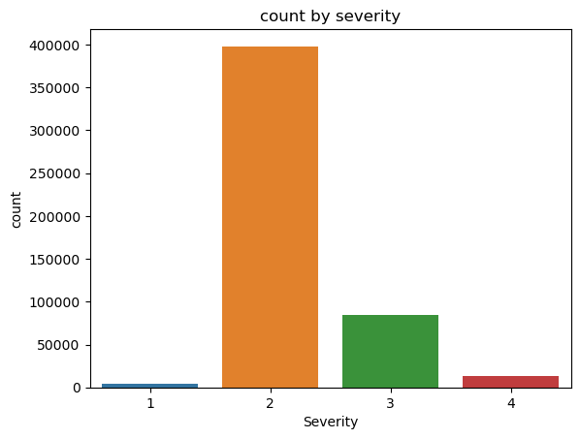
Balancing Severity: Addressing Class Imbalance
Imbalanced Severity Distribution:
Imbalance in the distribution of our target variable, 'severity’, with certain classes significantly outnumbering others.
Under sampling Approach:
To effectively handle the class imbalance, we categorized the severity levels and strategically adjusted our dataset using under sampling. This approach involved matching the size of the minority class.

Slide 16
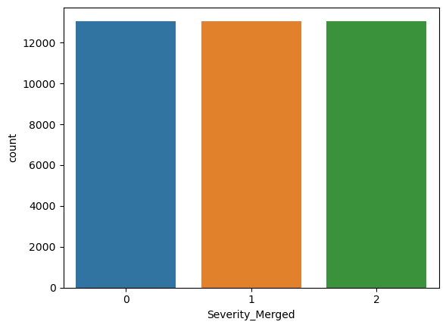
Balancing Severity: Addressing Class Imbalance
Utilizing a severity mapping strategy, we transformed the severity levels into a more manageable format, with values ranging from 0 to 2.
This mapping, represented as severity mapping = {1: 0, 2: 0, 3: 1, 4: 2}, facilitated our data preprocessing phase and contributed to the overall robustness of our analysis.

Slide 17
84%
78%
71%
60%
Model Comparison
47%
KNN
SVM
Gradient
Boosting
Logistic
Regression
Random Forest

Slide 18
Azure Deployment

Slide 19
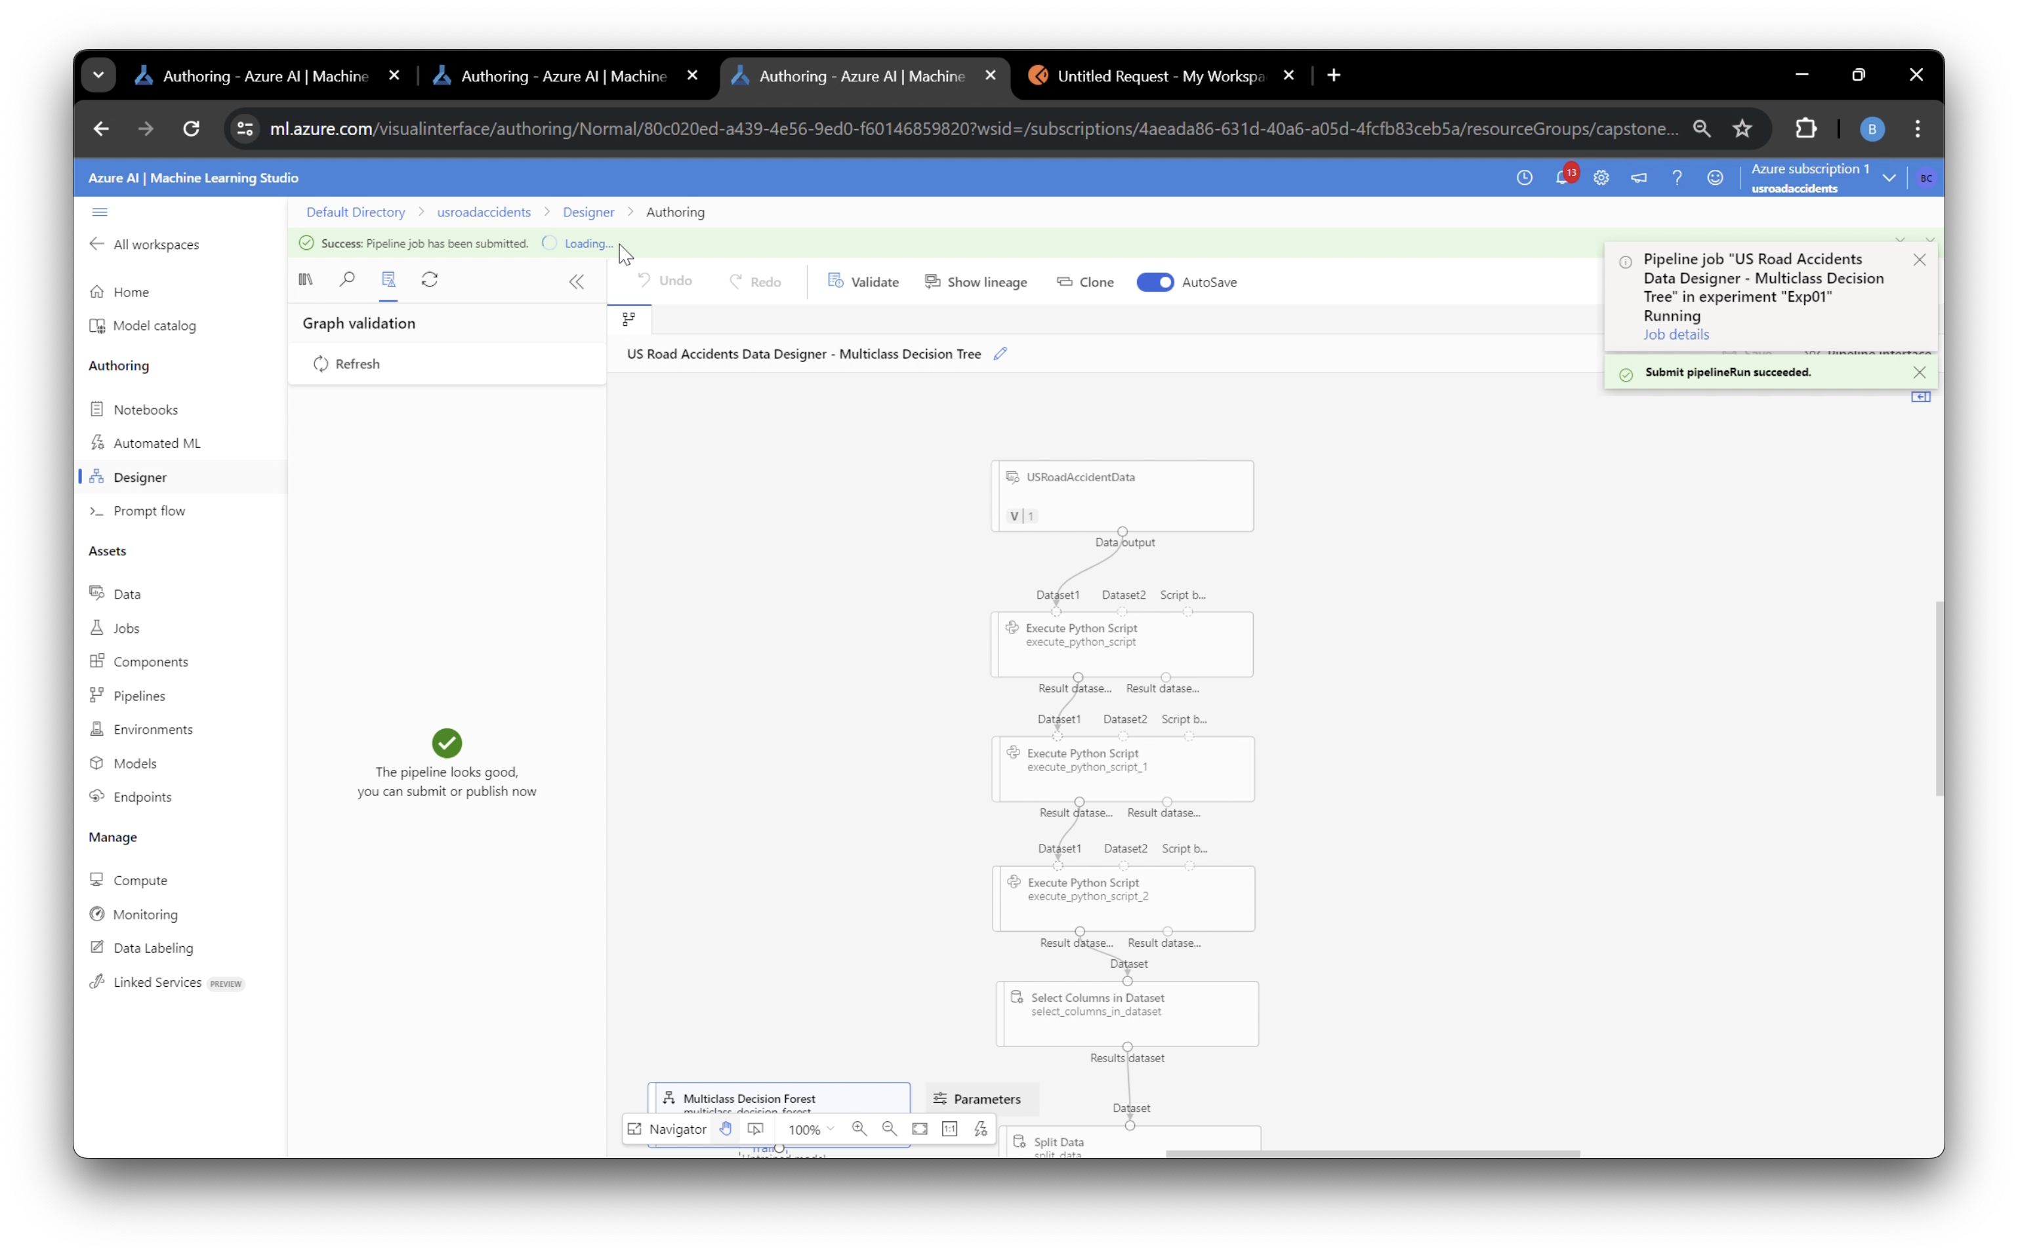
Azure pipeline and Deployment

Slide 20
Thank You
For Your
Attention

